Slide 1
AGREEMENT FOR
CLIMATE TRANSFORMATION

Slide 2
ACT 2015 Partners:
ACT 2015 is supported by:

Slide 3
PARIS AGREEMENT’S SEVEN CORE FUNCTIONS
Send a clear signal that the low-carbon economy is inevitable
Connect the global agreement to the “real economy” and “real people”
Provide transparency and accountability
Accelerate investment in low-carbon, climate resilient economies
Build a basis for climate action that demonstrates fairness
Ensure the vulnerable have the capacity to build resilience and adapt
Link to science with a sense of urgency
Image: NASA

Slide 4
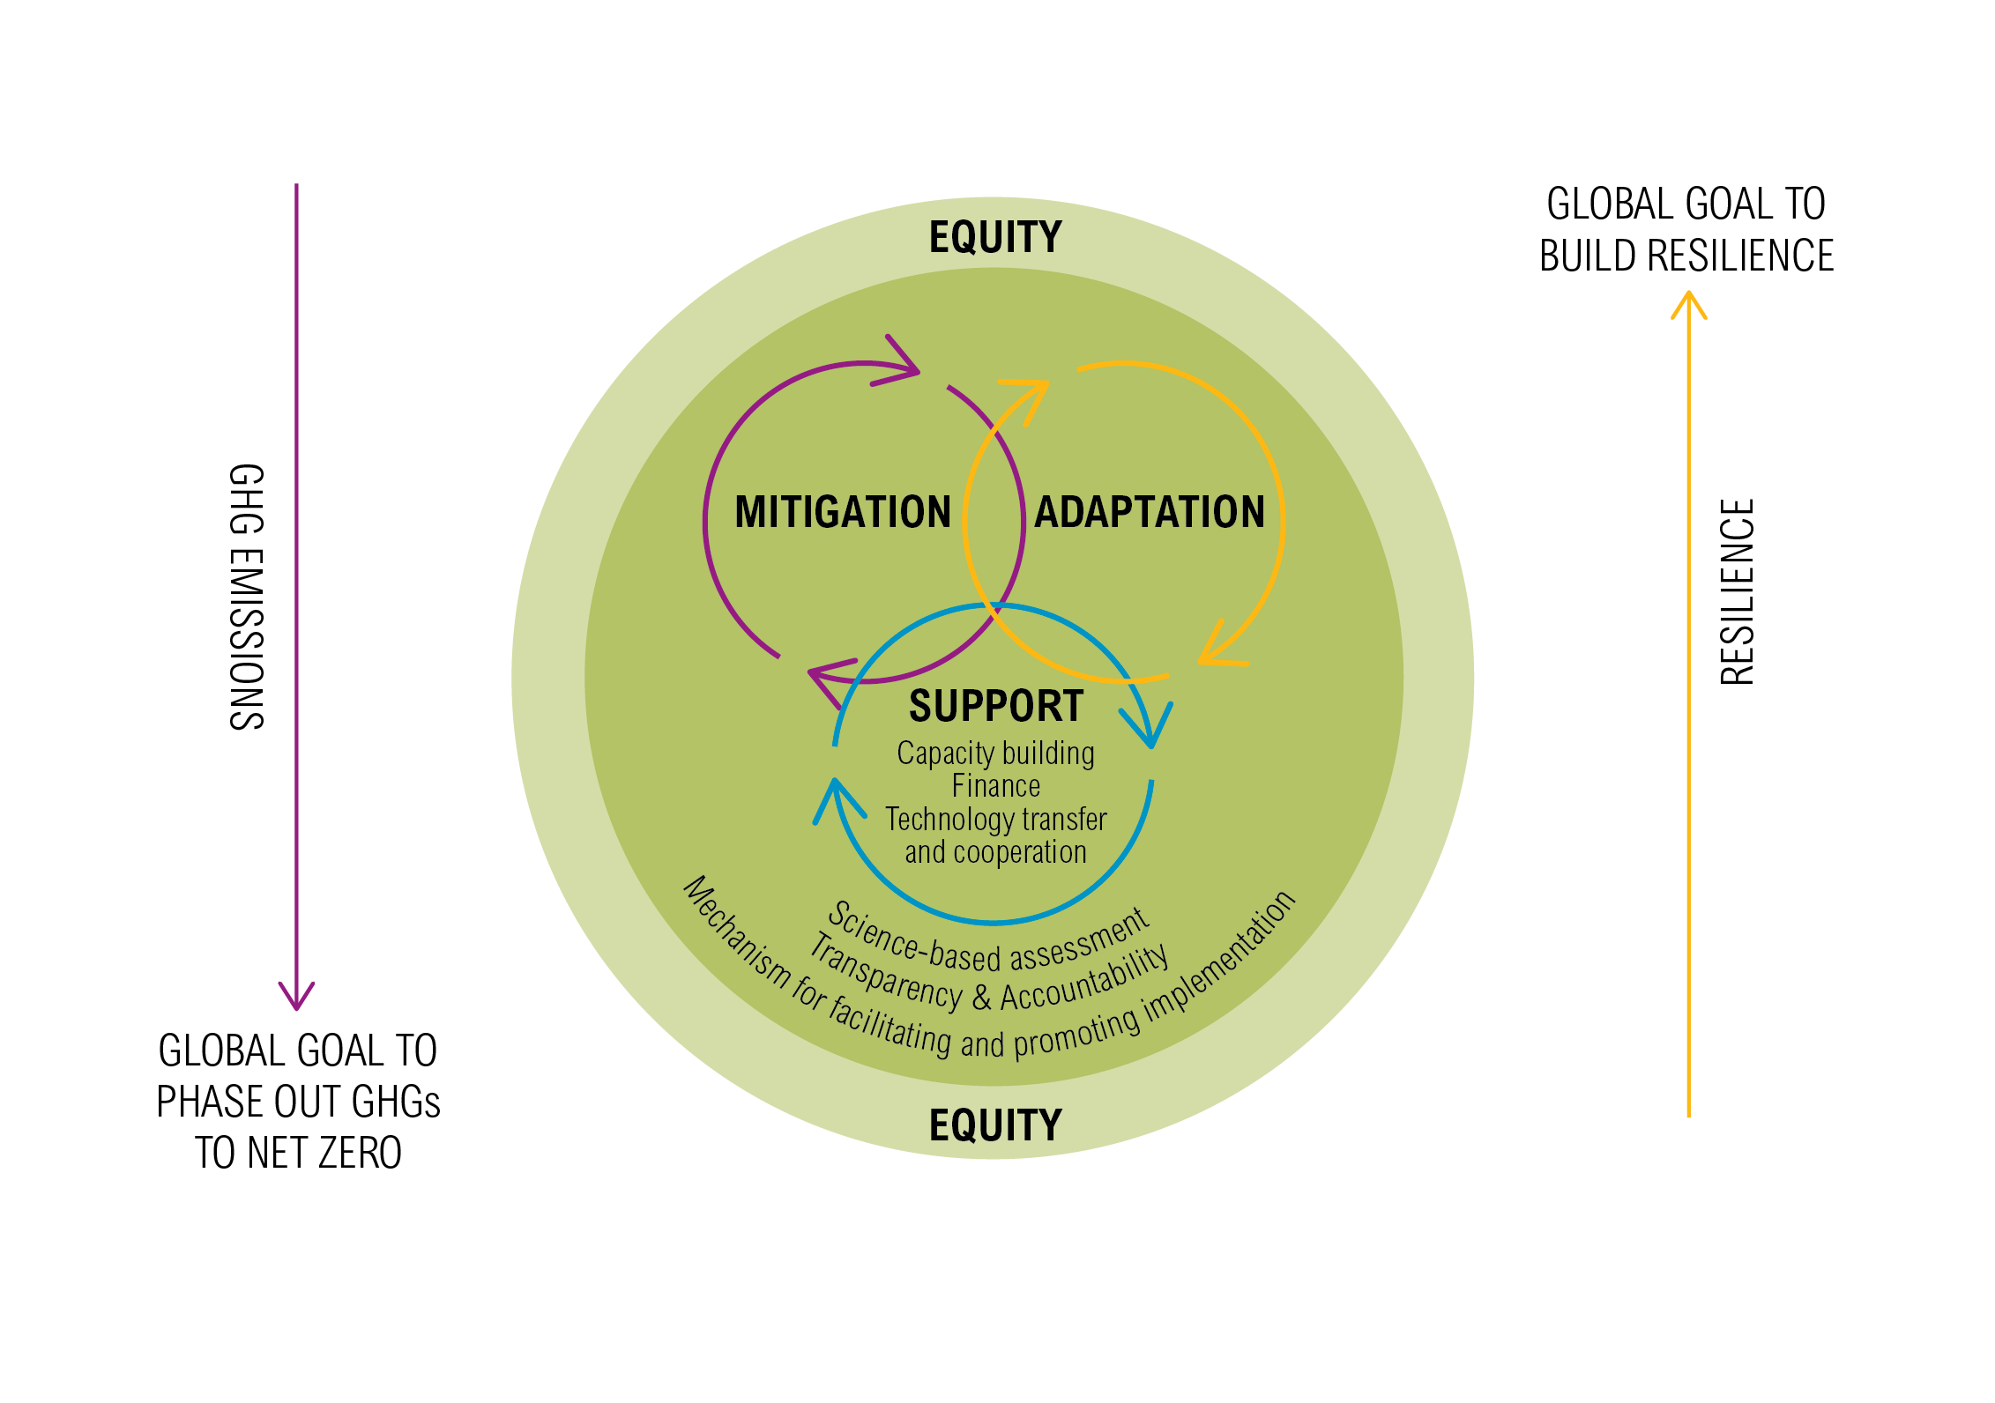
GLOBAL AGREEMENT
The package: binding Agreement + decisions + political declaration

Slide 5
CHOICES ON EQUITY
Then how to address equity?
Formal process with set criteria?
Equity framework
Yes
No
Provision of support for developing countries
Special LDCs/SIDS treatment
Balance
(3 cycles + L&D)
Types of commitments, robustness and type of information based on capability

Slide 6
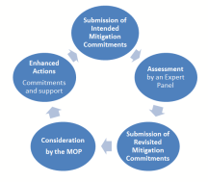
ELEMENTS OF MITIGATION (1)
Parties shall prepare, regularly update, and implement mitigation commitments
The ambition of all Parties’ mitigation commitments shall be raised in a continuous mitigation cycle every five years, informed by and informing the adaptation cycle and the support cycle
Developing countries, including, in particular, least developed countries and small island developing States, shall be eligible for support
Least developed countries and small island developing States shall have particular flexibility

Slide 7
ELEMENTS OF MITIGATION (2)
Each Party may at any time submit mitigation commitments that are additional
An independent expert panel is established to undertake individual and global assessments, which will be considered by the MOP
Competent IO and NGOs, and sub-national authorities are encouraged to provide input
Market and non-market mechanisms and new economic mechanism(s) allow for cooperation between Parties

Slide 8
CHOICES ON MITIGATION
Setting commitments?
How to close the gap?
What’s the long term goal of the cycle?
Internationally
negotiated
Nationally determined
Long-term goal
Emission reduction target
No roll-back + strengthen
Common accounting
Phase out all greenhouse gas emissions to net zero
Ex ante assessment
Global decarbonization
5 year cycle

Slide 9
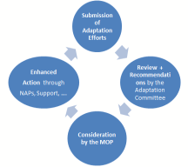
ELEMENTS OF ADAPTATION (1)
Shall prepare, regularly update and implement adaptation efforts statements
The adaptation effort shall be enhanced, communicated and updated in a continuous adaptation cycle, informed by the mitigation cycle and the support cycle
The MOP shall consider, every five years, ways to enhance adaption action
The Adaptation Committee shall, upon submission of the adaptation efforts statements, every five years, undertake a review and submit a report

Slide 10
ELEMENTS OF ADAPTATION (2)
Shall aim to ensure the allocation of public finance is balanced (equal allocation)
Developing countries, including, in particular, least developed countries and small island developing States, shall be eligible for support
Relevant international organizations and expert bodies outside the Convention are encouraged to cooperate and invited to report regularly on their actions and activities to achieve the long-term adaptation goal

Slide 11
CHOICES ON ADAPTATION
Further Enhancement
Goal or No Goal?
Goal?
Political Parity
Quantitative
Qualitative
5-year cycle
MRV
(or M & E)
Effort statement
Adaptation committee role
50-50 finance split
NAPs undertaken for different temperature scenarios

Slide 12
CHOICES ON LOSS & DAMAGE
Is Loss & Damage in the Agreement?
What is the vehicle?
What are the functions?
Goal or No Goal?
Goal or No Goal?
Extend the WIM beyond 2016
Accelerate work under the WIM
YES
NO
Compensation regime
Additional research and scoping studies or pilots
Specific requirements

Slide 13
ELEMENTS OF ADDITIONAL COOPERATIVE ACTION
Parties may prepare, communicate and implement joint agreements to cooperate on actions that represent a progression
These supplementary actions may include non-state actors
Parties may work with other international organizations in pursuit of cooperative action
Guidelines for recognition and contributions by subnational and non-State actors

Slide 14
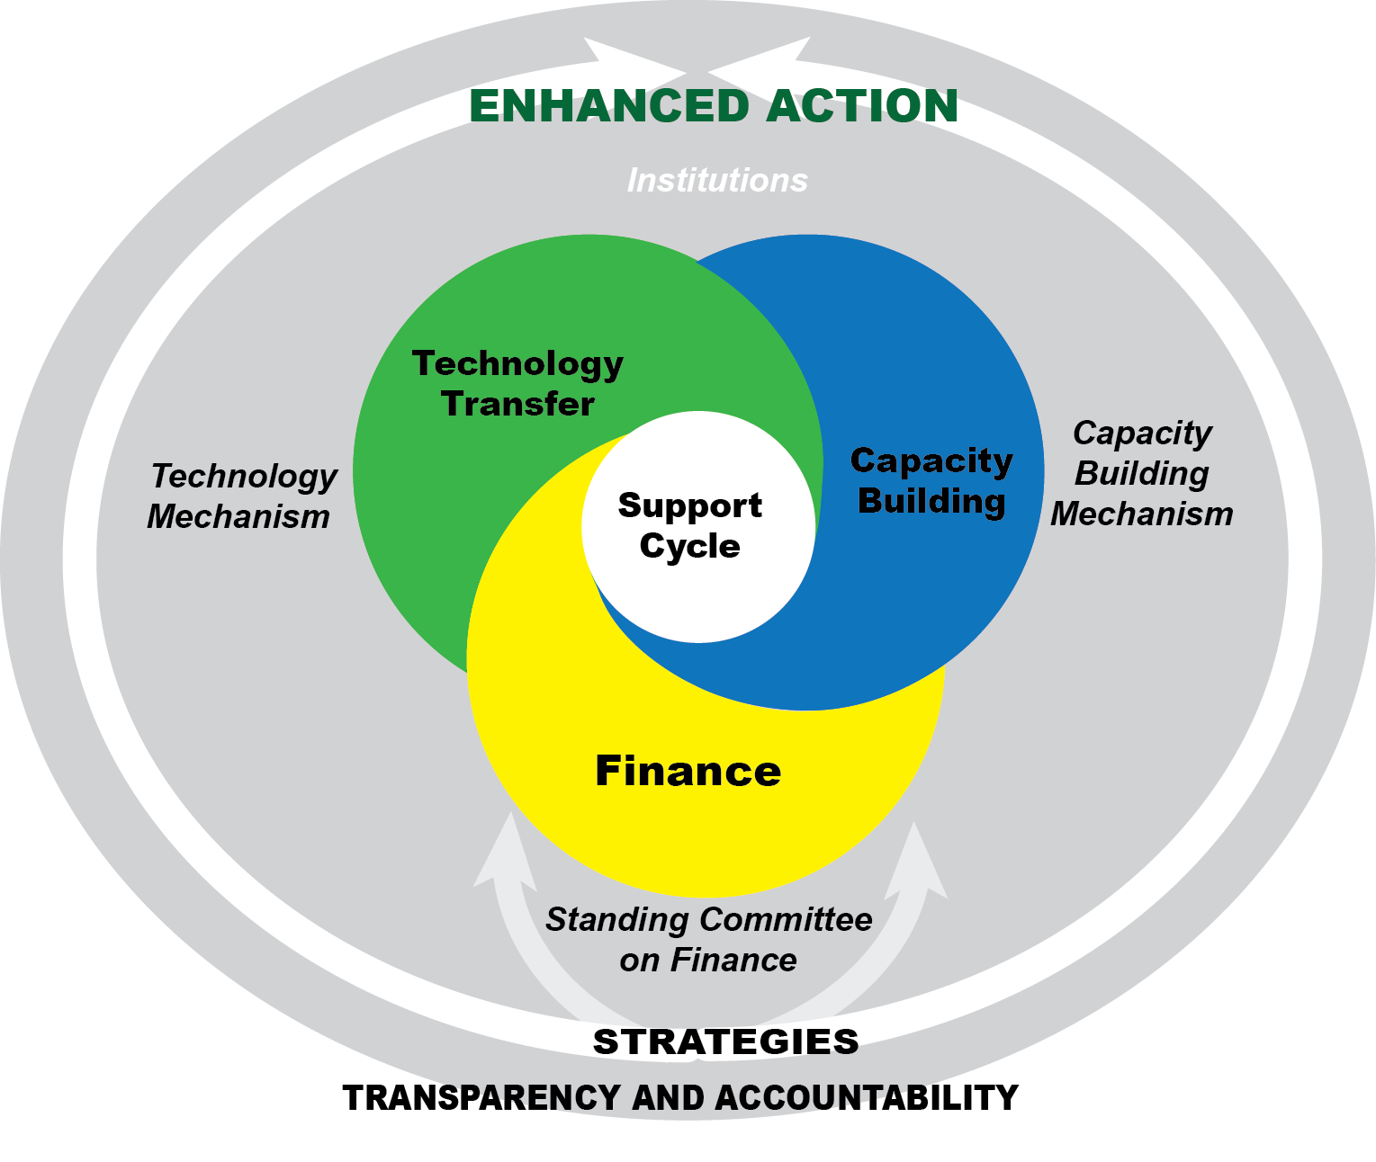
SUPPORT CYCLE
Review and Consideration by the MOP
Finance Strategies
Synthesis of Finance Strategies by SCF
Enhanced Action e.g. scaled up finance.
Inputs:
National reports
Biennial assessments
Reports by financial Institutions
Equity Framework
GOAL: Support mitigation and adaptation goals and shift the agenda

Slide 15
ELEMENTS OF FINANCE (1)
Parties shall shift and scale-up investments for low carbon and climate-resilient development
Developed country Parties shall make financial contributions and mobilize finance at an increasing scale from a floor
Other Parties, regularly determined by the MOP, shall also provide financial contributions
Parties shall improve national policy and institutional frameworks for climate finance

Slide 16
ELEMENTS OF FINANCE (2)
Every five years, until the LTGs are met, the provision of climate finance shall be scaled up as part of a continuous support cycle
Each Party shall prepare and submit finance strategies
Standing Committee on Finance shall prepare and provide, for the MOP a synthesis and aggregate analysis of the strategies
Parties shall work with and through national and international financial institutions in order to align investment decisions and policies w the LTGs

Slide 17
CHOICES ON FINANCE
Numbers in the Agreement?
Credible pathway
in the Agreement
Support Cycle
5 yr cycles
Yes
Finance Cycle
No
Finance strategies
Capacity building mechanism
Standing committee
Technology development and transfer
More MRV
Alignment of
IFIs with climate
objectives
Replenishment of the GCF
More Parties contribute in the future

Slide 18
only developed countries
CHOICES ON TECHNOLOGY
Should we create a new TT mechanism?
How do we enhance existing technology transfer?
YES
Set goals for all Parties in the Agreement
Create specific commitments for developed country Parties
NO
What kind of goal?
Increase diffusion of climate technologies
Enhance national enabling environments
What kind of goal?
Increase public funding for R&D
How to spend the funding?

Slide 19
CHOICES ON CAPACITY BUILDING
Should we create a new CB mechanism?
What should be its focus or function?
YES
Enhance institutional and legal framework
Adequate and dedicated financial support
Monitoring and review of efforts and support
Provide advice and guidance
NO
How to spend the funding?

Slide 20
COMMONALITIES AND DIFFERENCES BETWEEN THE CYCLES
 | What is common | What is different
 |  | Mitigation | Adaptation | Finance/Support
5-year cycle | Submissions every 5 years | Mitigation iNDCs/ Commitments | Adaptation Efforts Statements | Finance strategies (to include pathways and investment plans)
Assessment Process | MRV framework + additional Review or Assessment + Consideration by the MOP | Ex-ante assessment by Expert Panel | Review and recommendations by Adaptation Committee | Synthesis assessment by SCF Consideration by the MOP in conjunction with technology & CB
Reporting | National Communications every 4 years | National reports every 2 years | NAPs, NAPAs (no frequency) | National reports every 2 years

Slide 21
ELEMENTS OF TRANSPARENCY AND ACCOUNTABILITY (1)
All Parties shall work towards improving transparency in a continuous and sustained manner over time, taking into account national capabilities and circumstances. No less than existing rules, methodologies and guidelines.
Every two years each Party submits a national report including progress on implementation on mitigation and support
More comprehensive report every four years, that includes information on adaptation efforts and plans
Two-phased assessment
Technical evaluation of individual reports
Multilateral appraisal based on the output of the technical evaluation

Slide 22
ELEMENTS OF TRANSPARENCY AND ACCOUNTABILITY (2)
Common Guidelines to be elaborated:
Common global accounting framework that includes the land use sector and transferable emission units
Common methodologies for risk, vulnerability assessments
Common methodologies for tracking and reporting on financial flows

Slide 23
CHOICES ON TRANSPARENCY AND ACCOUNTABILITY
Is the existing system sufficient?
How do you improve the system?
YES
NO
Same reporting obligations for all countries now
Adjust existing reporting obligations based on capabilities/ circumstances
All countries improve, but responsibilities and capabilities vary
Enhanced MRV of actions and support
How do you support developing countries?
Lower their requirements
Provide financial and technical support

Slide 24
MECHANISM FOR FACILITATING AND PROMOTING IMPLEMENTATION
A mechanism to facilitate and promote implementation, including an implementation committee is established
Non-adversarial and facilitative and shall aim at facilitating and promoting compliance
Procedure triggered by Parties or through assessment process
Shall be able to issue its finding independently & have effective measures available
The MOP, at its first session, shall adopt further modalities and procedures

Slide 25
ELEMENTS OF LEGAL FORM
The package: Binding Agreement + decisions + political declaration
Within the Binding Agreement:
Binding conduct linked to result (implementation of commitments), binding procedures (MRV)
Tools for Robustness/Accountability:
Transparency and Accountability Framework
Compliance (facilitative mechanism)

Slide 26
only developed countries
CHOICES ON LEGAL FORM: ADAPTATION
Is the Agreement itself legally binding?
Provisions within the Agreement?
YES
Legally binding performance e.g. shall achieve
Legally binding conduct e.g. ‘shall implement’
Legally binding procedures e.g. shall maintain, review, update
NO
Where are the mitigation commitments located?
Where are the adaptation effort statements located?
Shall be publicly recorded as decided by the COP
What kind of goal?
In an annex inside the Agreement
In a registry
How to spend the funding?

Slide 27
only developed countries
CHOICES ON LEGAL FORM: MITIGATION
Is the Agreement itself legally binding?
Provisions within the Agreement?
YES
Legally binding conduct linked to result e.g. ‘shall implement’
Legally binding performance e.g. shall achieve
Legally binding procedures e.g. shall maintain, review, update
NO
Where are the mitigation commitments located?
Inscribed in a list kept by the Secretariat alongside the Agreement – defined procedures for change
Where are the mitigation contributions/commitments located?
What kind of goal?
In an annex inside the Agreement
In a schedule
How to spend the funding?
Notes:
In conclusion:
Through our proposal, we are combining the bindingness of conduct and bindingness of result by:
- Having countries bound to implement their mitigation commitments with a view to induce policy change - (bindingness of conduct)
- Providing a clear direction (Long term goals), benchmark for the compliance assessment (ex post MRV and Implementation mechanism) and the link to the result/commitments – (result)

Slide 28
THANK YOU !
ACT 2015 Partners:
ACT 2015 is supported by:

