Slide 1
Japan’s INDC
May 15, 2015

Slide 2
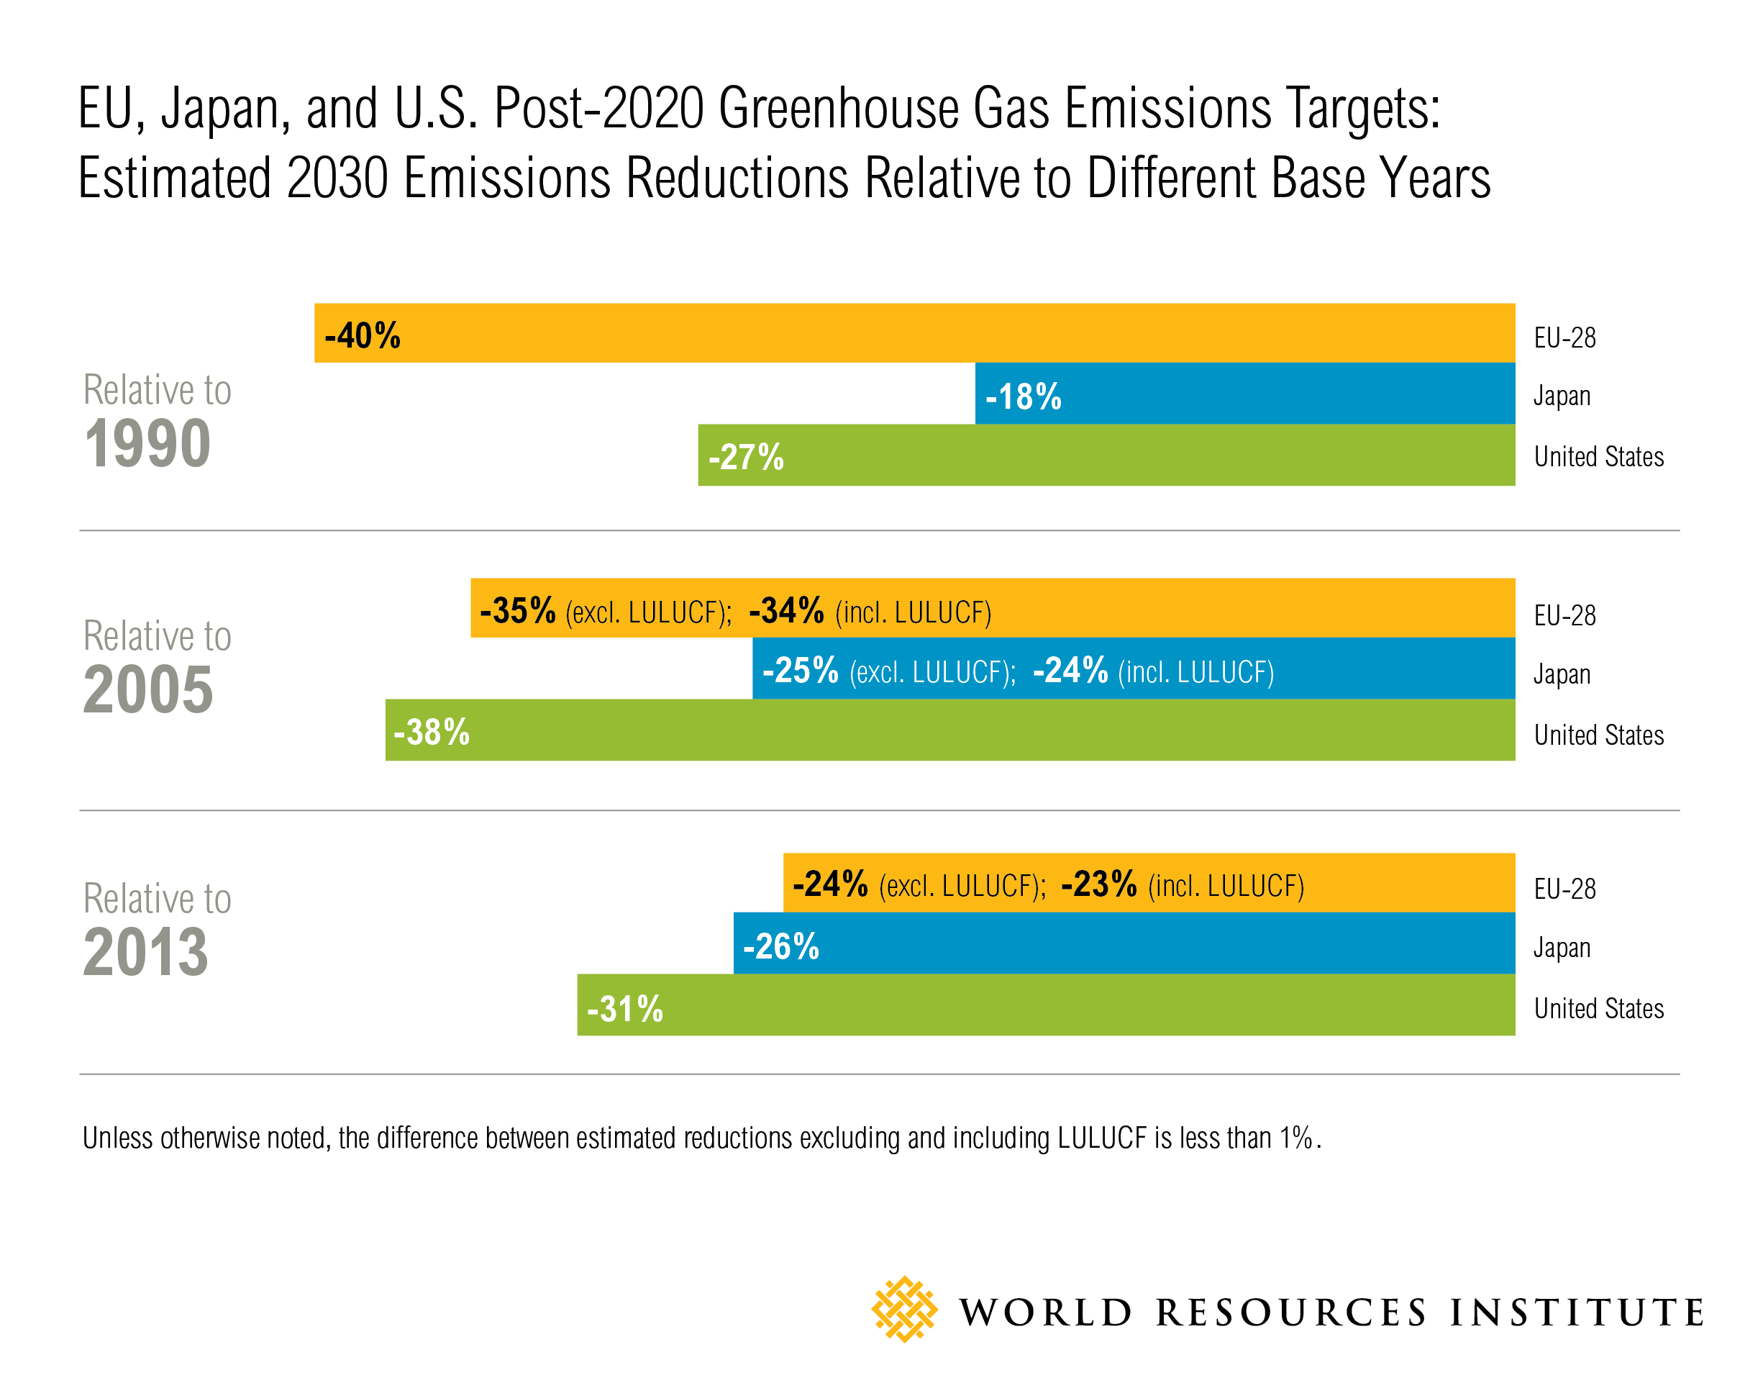
THE EU, The us, and japan
Notes:
The EU-28 and the United States have put forward greenhouse gas reduction targets in their intended nationally determined contributions (INDCs) to the United Nations Framework Convention on Climate Change, and Japan has published a draft of its proposed target. Each country uses a different base year from which to measure its reductions: the EU-28 uses 1990, the United States 2005, and Japan 2013. This chart presents each target against each chosen base year to facilitate comparison.

Slide 3
Comparison of EU, Japan, and U.S. Average Annual Decarbonization Rates: 2020-2030
Lines represent calculations excluding and including LUCF
U.S. = -2.8%
EU = -2.8%
Japan would need to increase its proposed INDC mitigation goal to at least a
28% reduction from 2005 levels by 2030
to achieve an average annual decarbonization rate similar to that of the EU and U.S. for the 2020-2030 time period.
Notes:
Based on preliminary WRI analysis.

